Slide 1
MIS 547
Cloud Computing

Slide 2
Admin
Reminders
01
Assignment 4 Due Sunday @ midnight
02
Office hours
04
By appointment, please schedule in advance!
Back in person next week
Quiz 4 Due Sunday @ midnight
03

Slide 3
Admin
Assignment 5 is a practice exam!
It is due at 3:00pm on Thursday September 26th!

Slide 4
AGENDA
Agenda:
Load Balancing
More VPC Connectivity Options
Security Groups
VPC Design Considerations
Network Access Control Lists
BYOIP
Exam Topics Overview

Slide 5
Lecture 8: Cloud Networking Day 2

Slide 6
Load Balancing

Slide 7


Load Balancers
Modern applications process millions of users simultaneously
High-traffic necessitates many redundant resource servers with duplicate data and software to serve the users
Load balancers distribute appropriate workloads/traffic/requests to redundant servers
myapp.com
Load Balancer
App Server 1
App Server 3
App Server 2

Slide 8
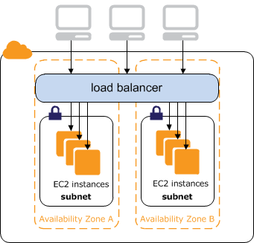
Load Balancing
Load balancers distribute workloads across available servers
They are designed to identify which servers are available to handle additional demand so that customers don’t see a decline in performance.
A load balancer sits between a user and a cluster of servers; it analyzes which server would best meet the user’s request and then routes the traffic to the available server
Source: AWS Documentation

Slide 9
Why Use Load Balancing?
Availability
Scalability
Security
Performance

Slide 10






Load Balancing Benefits
Availability
myapp.com
Increase fault tolerance of systems by automatically detecting server problems and redirecting client traffic to available servers
Load Balancer
Run application server maintenance or upgrades without application downtime
Provide automatic disaster recovery to backup sites
App Server 1
App Server 3
App Server 2
Perform health checks and prevent issues that can cause downtime

Slide 11


Load Balancing Benefits
Scalability
Prevent traffic bottlenecks at any one server
Add redundancy to your system so that you can scale with confidence

Slide 12




Load Balancing Benefits
Security
Handle distributed denial of service attacks
Mirror traffic and block malicious content
Automatically redirect attack traffic to multiple backend servers to minimize impact
Route trafic through a group of network firewalls for additional security

Slide 13

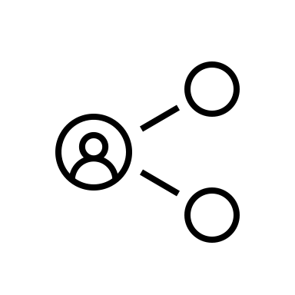


Load Balancing Benefits
Performance
Increase response time and reduce network latency
Distribute load evenly between servers to improve application performance
Redirect client requests to a geographically closer server to reduce latency
Ensure the reliability and performance of physical and virtual computing resources

Slide 14
Load Balancing
Both internet facing and private load balancers route requests to your targets using private IP addresses
Therefore, your resources don’t need public IP addresses
myapp.com
Load Balancer
App Server 1
App Server 3
10.0.0.7
App Server 2
10.0.0.9
10.0.0.8

Slide 15
Load Balancing Algorithms
Dynamic
Considers the state of each server and distribute traffic accordingly
Static
Distributes traffic using pre-defined rules

Slide 16
Load Balancing: Dynamic Algorithms
Least Connection
Checks which servers have the fewest connections open at the time and sends traffic to those servers. This assumes all connections require roughly equal processing power.
Weighted Least Connection
Gives administrators the ability to assign different weights to each server, assuming that some servers can handle more connections than others.
Weighted Response Time
Averages the response time of each server, and combines that with the number of connections each server has open to determine where to send traffic. By sending traffic to the servers with the quickest response time, the algorithm ensures faster service for users.
Resource-based
Distributes load based on what resources each server has available at the time. Specialized software (called an "agent") running on each server measures that server's available CPU and memory, and the load balancer queries the agent before distributing traffic to that server.
Least Response Time
The total time that the server takes to process the incoming requests and send a response. The least response time method combines the server response time and the active connections to determine the best server

Slide 17
Load Balancing: Static Algorithms
Round Robin
Distributes traffic to a list of servers in rotation using DNS. An authoritative nameserver will have a list of different A records for a domain and provides a different one in response to each DNS query.
Weighted Round Robin
Allows an administrator to assign different weights to each server. Servers deemed able to handle more traffic will receive slightly more. Weighting can be configured within DNS records
IP hash
Combines incoming traffic's source and destination IP addresses and uses a mathematical function to convert it into a hash. Based on the hash, the connection is assigned to a specific server.

Slide 18

Load balancing
External load balancing
Handles requests coming from outside your network (e.g., from the internet)
Internal load balancing
Handles traffic coming from clients in the same VPC network as the load balancer
Assigned to a private subnet and does not have a public IP address

Slide 19
Load Balancing types
Application load balancer (ALB)
Network load balancer (NLB)
Gateway load balancer (GLB)

Slide 20
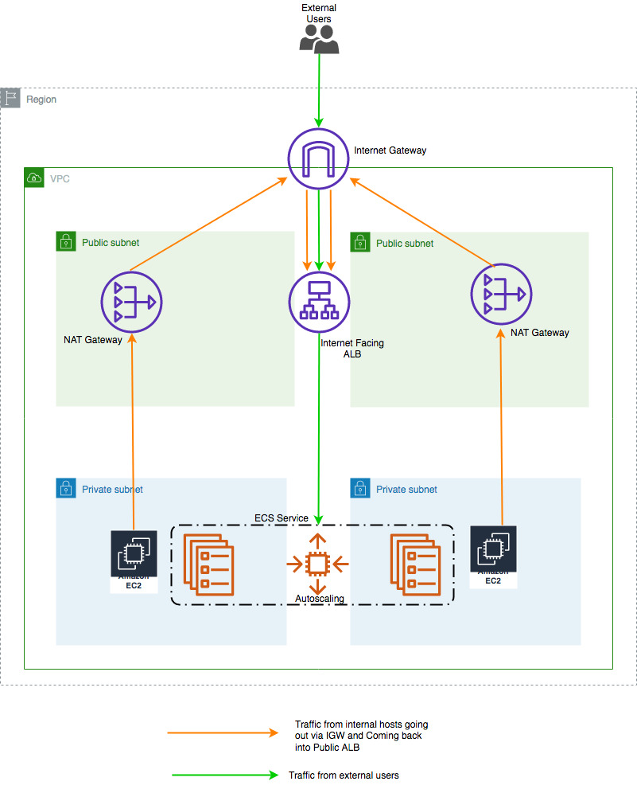
Application Load Balancing
Several server clusters (e.g. autoscaling group) with multiple servers dedicated to a single application function.
ALBs look at the request content (HTTP headers or SSL Session IDs) to redirect traffic.

Slide 21
Network Load Balancing
Distributes traffic based on network conditions, predetermined server IP addresses or server availability.
Monitors the health of targets and routes traffic only to healthy targets
The NLB receives a connection request and selects a target from the target group for the default route
NLB attempts to open a TCP connection to the selected target
Each individual TCP connection is routed to a single target for the life of the connection

Slide 22
Gateway Load Balancer
Deploy, manage, scale virtual appliances like intrusion detection and prevention, firewalls, and deep packet inspection systems
Single entry and exit point for all appliance traffic
Scales your virtual appliances with demand
Exchange traffic across VPC boundaries
Establish rules using route tables; depending on the rules that you set up, it selects different target groups to forward traffic to.
Receives IP packets and forwards traffic to specific target groups

Slide 23
Target Types
The endpoint that each of the load balancers route traffic to.
IP
Instance (VM, VSI)
Other load balancers

Slide 24
ALB vs NLB vs GLB
 | ALB | NLB | GLB
OSI layer | Layer 7 (application) | Layer 4 (transport) | Layer 3, Layer 7
Target types | IP, instances, serverless targets | IP, instance, ALB targets | IP, instance targets
Proxy behavior | Ends connection | Ends connection | Doesn’t terminate flow
Protocols | HTTP, HTTPS, gRPC | TCP, UDP, TLS | IP-based routing
Algorithms | Round-robin | Flow hash | Routing table lookup

Slide 25
DNS Load Balancing
Configure your domain to route network requests across a pool of resources on your domain.
Domain can correspond to a website, a mail system, etc. that is made accessible through the internet.
DNS load balancing is helpful for maintaining application availability and balancing network traffic across globally distributed pool of resources.

Slide 26
Global Server Load Balancing
Occurs across several geographically distributed servers.
Servers in multiple data centers, in different countries, in third-party cloud providers
Global Load Balancing:
Enables administrators to customize where regional traffic is handled to reduce the amount of distance that traffic travels

Slide 27
Security Groups
Controlling Instance Network Traffic

Slide 28

Security Groups
Security groups are a software firewall placed around each attached network interface (NIC)
A security group is a collection of inbound and outbound rules that designate the port and protocols allowed into and out of each NIC
Operate at the EC2 instance level
Security groups are attached to a VM’s NIC
Primary EC2 NIC is eth0 (can have multiple)
Each NIC can be associated with up to 5 security groups
Security groups are associated with a VPC
NIC
EC2
HTTP
Security group
Subnet traffic
SSH

Slide 29
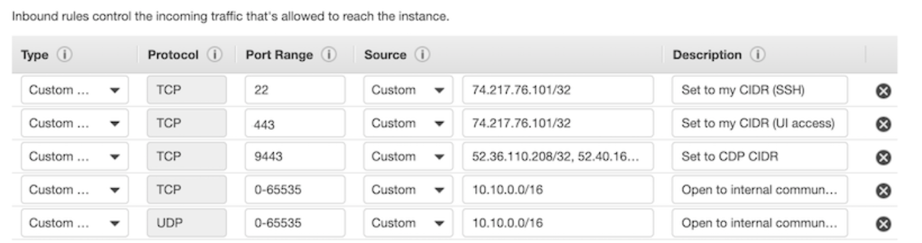
Security Groups
Inbound traffic is DENY by default
We set security group rules to ALLOW specified traffic
If access is not specifically allowed, it is implicitly denied
Outbound traffic is allowed by default when creating a new security group
Create the rules using the protocol, the port or port range, and the source inbound rules or destination outbound rules for the traffic

Slide 30
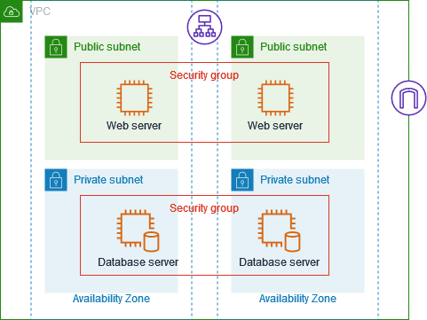
Security Groups
You can associate security groups with resources that perform the same function.
For example, you can associate all of your web servers with one security group and you database servers with a different security group.
Source: Wiz

Slide 31
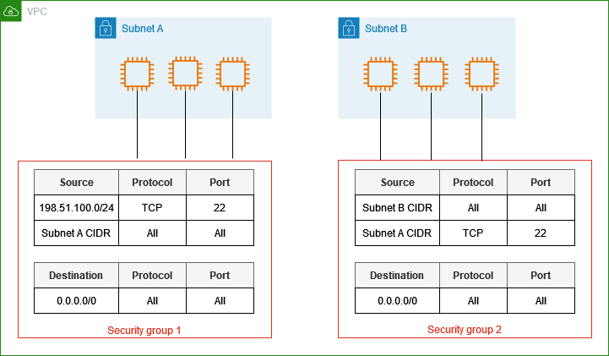
Security Groups
In this example, VMs in Subnet A allow inbound traffic from:
SSH connections from IPs in the 198.51.100.0/24 CIDR block
Traffic internal to the subnet
VMs in subnet B allow inbound traffic from:
Traffic internal to the subnet
SSH connections from Subnet A
All outbound traffic is allowed in each subnet.
Source: AWS Documentation

Slide 32
Security Groups
Defined as stateful; if requests are allowed in, the response traffic is allowed out regardless of the defined outbound rules.
However, an inbound port request does not necessarily use the same port number for outbound response
If a rule allows inbound HTTP on port 80, the outbound traffic response is allowed out, but the response traffic does not use port 80 outbound.
In most cases outbound traffic uses a dynamically assigned port called an ephemeral port (port is assigned by the underlying OS)

Slide 33
Security Group Best Practices
Restrict what ports need to be opened
If you place a load balancer in front of your EC2 instances, the only ports that need to be allowed by the security group protecting the load balancer are the port or ports your application requires.
Pick unique ports based on your production server’s tier placement
E.g. Web servers could be assigned port 3020
Application servers 3030
Database instances with custom ports chosen
Pick good names for your security groups!

Slide 34
Default Security Group
When you create a VPC, a default security group is created
Allows all outbound traffic between EC2 instances assigned the security group, however, any other traffic is implicitly denied.
Can’t delete it, but don’t have to use it.

Slide 35
Security Group Summary
Plan your security groups with names that make sense
Create security groups for administrative tasks
Create a security group for your public-facing load balancer that sends traffic to your web tier security group
Create a security group for your Web tier that sends traffic to your app tier or app tier load balancer security group
Create a security group for your app tier that sends traffic to your DB tier security group.
Deploy and test everything on a test VPC before deploying anything in production

Slide 36
Network ACLs
Controlling Subnet Traffic

Slide 37
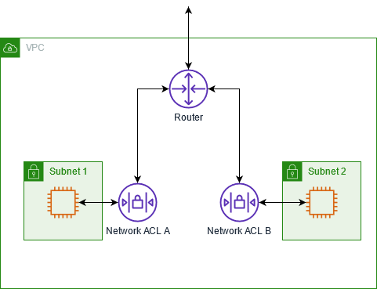
Network access control lists
NACLs are an optional software firewall that controls inbound and outbound traffic for each subnet within the VPC
Each NACL contains a set of inbound and outbound subnet traffic rules
A custom NACL can be associated with any subnet
A subnet can only be associated with one ACL
Source: AWS

Slide 38
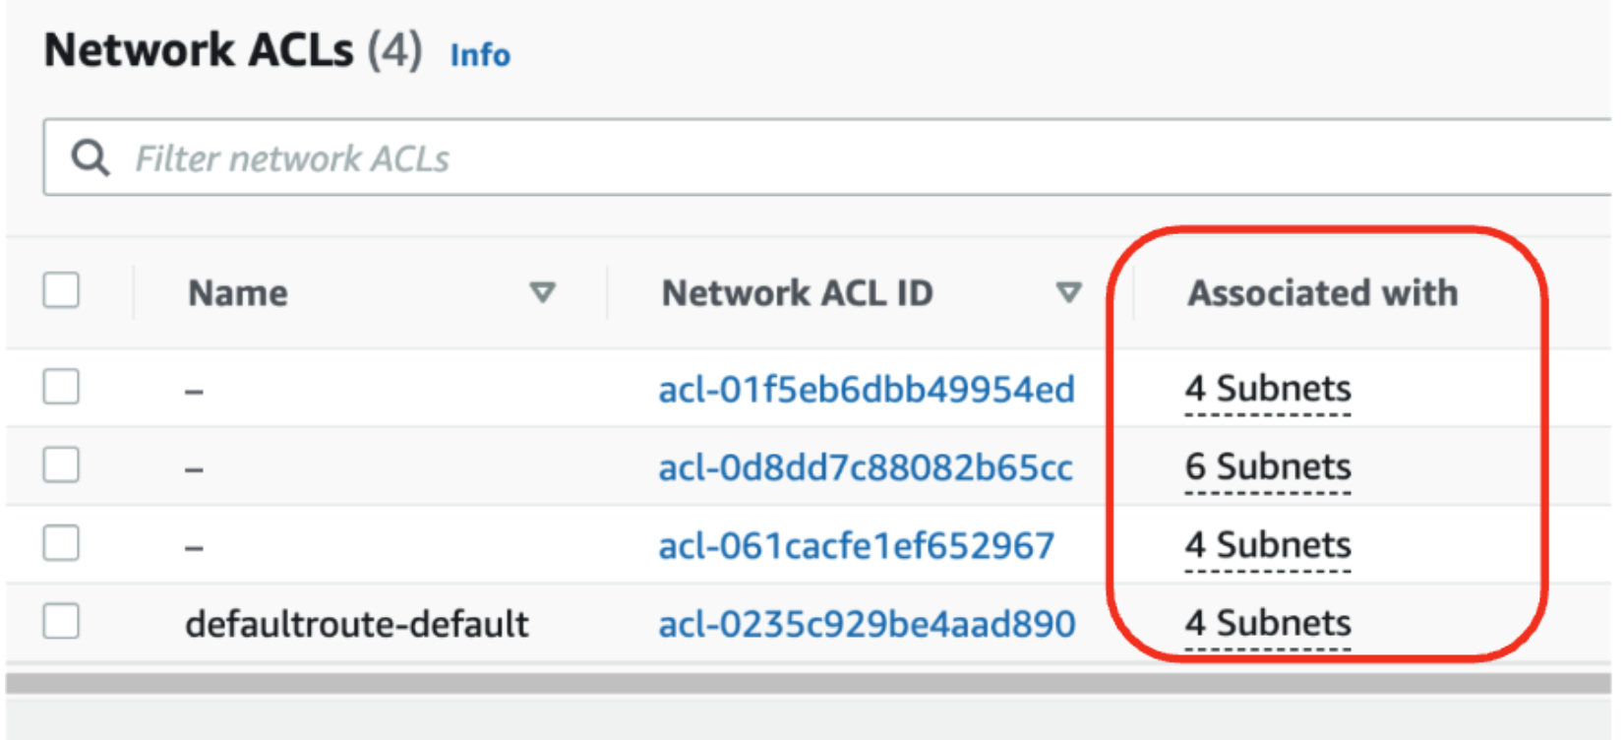
Network Access Control Lists
Each VPC has a default NACL
Allows all inbound and outbound IPv4 and IPv6 traffic at the subnet level
Source : Sysdig

Slide 39
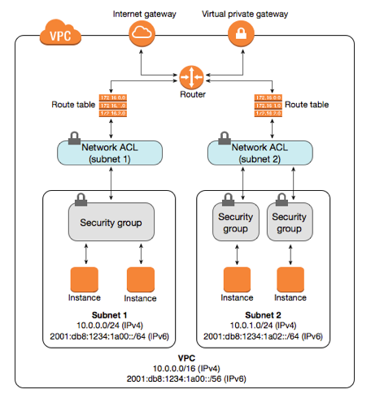
Network Access control lists
Why use NACLs if we have security groups?
ACLs operate at the lower subnet level and provide an additional layer of defense
A single NACL can protect multiple application servers at the subnet level
Rules can target an entire subnet or an individual IP
Make one NACL change and protect hundreds of instances rather than having to potentially change multiple security groups on each EC2 instance.

Slide 40
NACL Rules
Number in 10’s: 10 evaluated first, 20 second, etc.
Once a rule matches the traffic request, it’s applied, and no further rules are evaluated
Each rule must be defined as either ALLOW or DENY for the specified traffic
ACLs are stateless
Inbound and outbound rules are independent from each other
Return traffic from an instance in a VPC to a destination outside the VPC would be communicating using an ephemeral port.

Slide 41
Ephemeral Ports
TCP/IP communications don’t utilize the same inbound and outbound ports
The ephemeral port is a temporary port assigned by the OS TCP/IP stack
Port number is chosen by TCP/IP implementation based on host OS
Windows 2008 R2 and above: port range is 49152-65535
Linux: port range isn32768 to 61000
SSH: destination traffic always port 22, but return traffic from the server to client is from an ephemeral port

Slide 42
NACL + Ephemeral Ports
If custom NACLs are deployed, ephemeral rules need to appear in both the inbound and the outbound rules.
Outbound comms from an instance in a VPC needs to have an allowed outbound range of ephemeral ports
Each dynamically assigned port is released after the TCP connection terminates

Slide 43
NACL + Ephemeral Ports
Inbound Ports | Service | Protocol | Description | Outbound Port
20 | FTP | TCP/UDP | File Transfer Data | Dynamic
21 | FTP | TCP/UDP/ | File Transfer Control | Dynamic
22 | SSH | TCP/UDP/SCTP | Secure Shell | Dynamic
25 | SMTP | TCP/UDP | Simple Mail Transfer | Dynamic
67 | BOOTPS | UDP | Bootstrap (BOOTP/DHCP) Server | Dynamic
68 | BOOTPC | UDP | Bootstrap (BOOTP/DHCP) Client | Dynamic
69 | TFTP | UDP | Trivial File Transfer | Dynamic
80 | HTTP | TCP | Hypertext Transfer Protocol | Dynamic
In 88 | Kerberos | TCP | Kerberos | Dynamic
123 | NTP | UDP | Network Time Protocol | Dynamic
443 | HTTPS | TCP | HTTP protocol over TLS / SSL | 443
143 | Microsoft-ds | IMAP | Internet Message Access Protocol | Dynamic
Notes:
*Bootstrap protocol is used to automatically assign an IP address to network devices from a configuration server
Parts of BOOTP are used to provide service to the DHCP protocol.
*Kerberos is a protocol for authenticating service requests between trusted hosts across an untrusted network. Kerberos support is built in to all major computer OS.
Uses shared secret cryptography to prevent packets traveling across the network from being read or changed

Slide 44
BYOIP
Bring your own IP

Slide 45
BYOIP: When to Use it
Allows customers to move their existing public IPv4 address space to AWS
Lets you maintain your public IP reputation
Avoid any changes to public IP addresses that have been allow listed
Avoid changing legacy applications that utilize IP addresses
Use a public IP address as a standby failover for on-prem resources

Slide 46
BYOIP: WHY Use it
Keep a recognizable public IP address but have the service assigned to that address hosted on AWS
10,000 hard-coded lottery machines and you wanted to change hardware devices to virtual ones at AWS with your IP addresses
2,000 hard-coded public IP addresses within your data center and you wanted to change the physical location of your data center to AWS but keep the same public IP addresses
Legacy workloads, older applications relying on specific fixed public IP addresses

Slide 47
VPC Connectivity
Routing Traffic to an enterprise network
Routing Traffic between VPCs

Slide 48
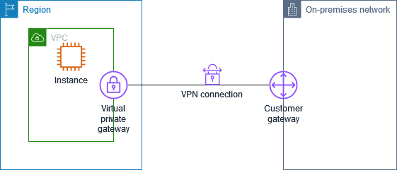
VPN Connections
Virtual Private Network is a site-to-site tunnel connection between your VPC and your corporate network (or remote workforce)
Can be facilitate through client VPN or site-to-site VPN connections
Source: AWS Documentation

Slide 49
Site-to-Site VPN Connection
Need to attach a Virtual Private Gateway (VPG) that is directly attached to the VPC where access is desired
VPG is the VPN concentrator on the AWS side of the connection (VPC side)
Add VPG to the route table
Source: AWS Documentation

Slide 50
Site-to-Site VPN Connection
VPN connections can have static routes or dynamic routes
VPN connections with a single static route won’t have a failover option
Dynamic route VPN connections can reroute traffic as needed to other available routes
Each VPN connection is created with two VPN endpoints on the Amazon side
Each tunnel is assigned with a unique public IP address

Slide 51
VPN Connections
Two choices for connecting your data center to AWS:
A secure VPN connection
A fast and secure connection using Direct Connect high-speed private connection.

Slide 52
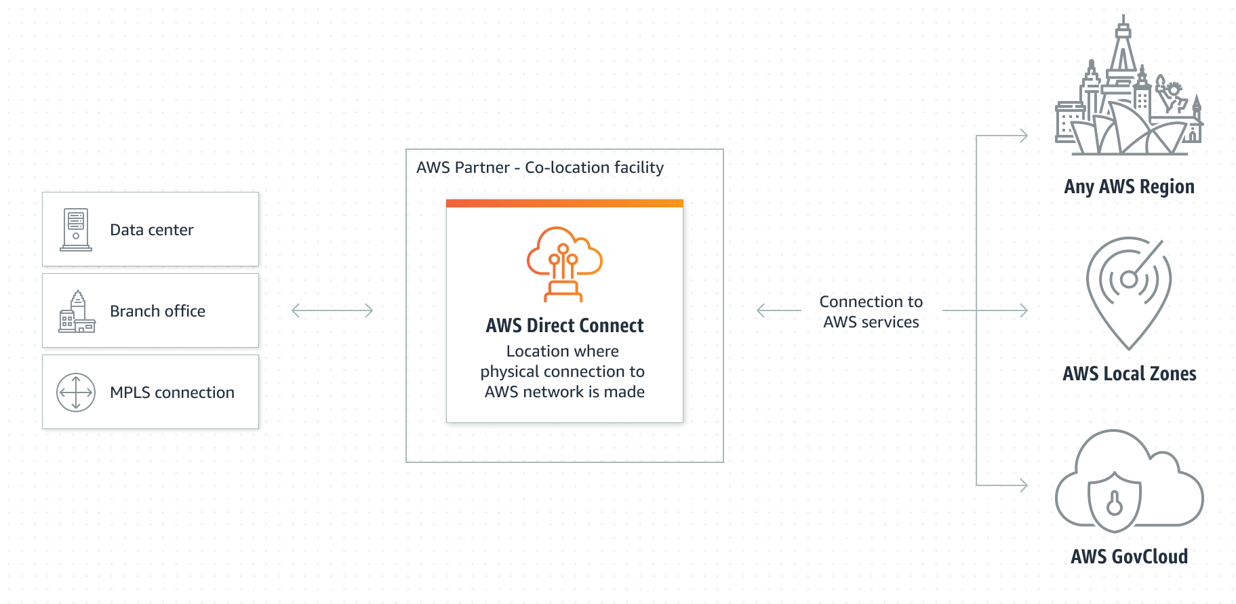
Direct Connect
Connect your internal corporate network to a Direct Connect location over a private high-speed fiber connection
High-speed highway can be ordered with port speeds up to 10Gbps
Single dedicated connection from your routers to the routers at AWS
$$$
Connection is made using a single fiber pair running from a physical piece of customer equipment that must be in the same facility as the AWS Direct connect inter-connect.

Slide 53
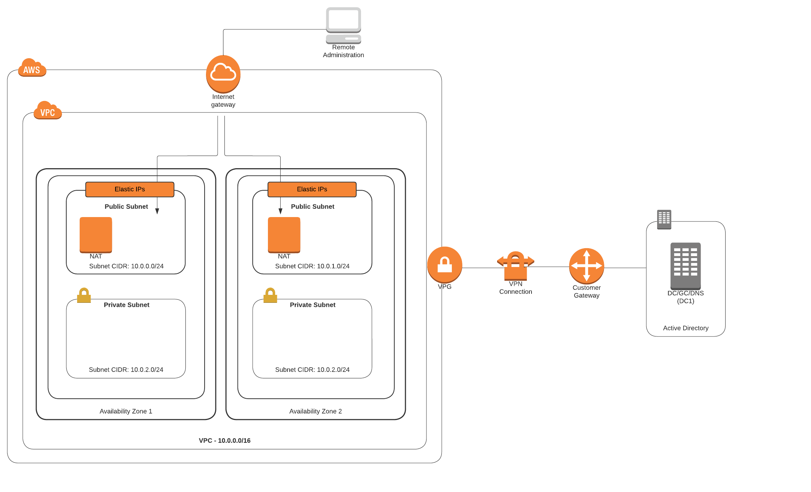
Site-to-site VPN Connections
On customer side, add the Customer Gateway (can be hardware or software appliance)

Slide 54
VPN Connections: Customer Gateway
On the customer side of the VPN connection is an appliance (can be hardware or software)
Most popular customer hardware are Cisco, Checkpoint, Fortinet, Juniper, Palo Alto
Config steps for these are provided by AWS
When creating the customer gateway, provide the public IP address location of your hardware device and indicate the type of routing to be used (static or dynamic)

Slide 55
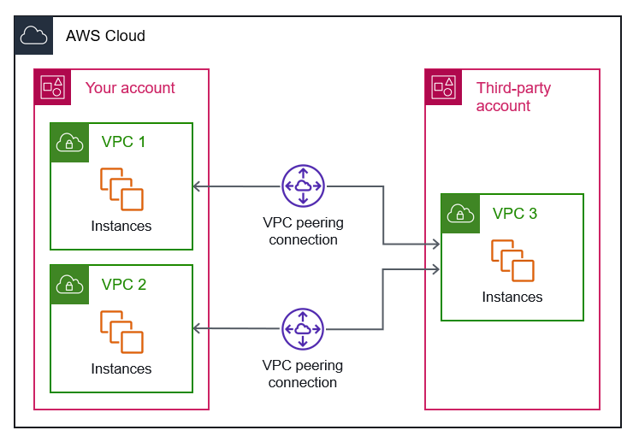
Peering VPCs
Enables traffic routing between VPCs
Not the same as a gateway or VPN connection
Can peer between VPCs in the same account or between VPCs in different accounts.

Slide 56
VPC Design Considerations

Slide 57
The Default VPC
When we spin up resources in AWS, by default they are placed into the default VPC.
All instances placed in the default VPC receive both a public and private IPv4 address and public and private DNS host names
What’s created for you with the default VPC:
1subnet in each Availability Zone in the region
1 Internet Gateway
A main route table
Default security group
Default network access control list (NACL)
Route Tables
DHCP is enabled in each subnet

Slide 58
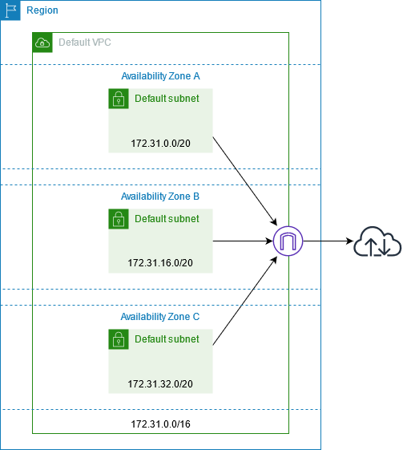
The Default VPC
Resource | Default Setting
VPC | /16 CIDR Block (65,536 IP addresses)
Subnets | Public subnet in each AZ with /20 CIDR Block (4,096 addresses per subnet)
Internet Gateway | Created
Route Table | Points all traffic 0.0.0.0/0 to the internet gateway, allows local routing within default VPC (see below)
Security Group | DENY by default
Network Access Control List | ALLOW all (inbound and outbound) by default
DHCP | Enables DHCP for resources that will be created in the subnets.
Destination | Target
172.31.0.0/16 | local
0.0.0.0/0 | internet_gateway_id

Slide 59
When to use Default VPC and When to Make your Own
Using the default VPC can cause deployment issues when you are selecting a service that requires network placement.
The default VPC isn’t a good choice when creating applications that should be isolated from each other.
For example, if you’re a web developer, your customer’s projects should each have their own VPC.

Slide 60
How Many VPCs do you need?
Long-term question
Might need a single VPC today, what about tomorrow?
Initial limits to number of VPCs that we can create in AWS:
Soft limit = 5 per account
Hard limit cannot exceed 1,000

Slide 61
Design Option and Considerations for the Number of VPCs you need
1. Your company wants to burst into the cloud. Your primary need is additional compute resources at certain times of the month.

Slide 62
Design Option and Considerations for the Number of VPCs you need
Your company wants to burst into the cloud; your primary need is additional compute resources at certain times of the month.
- One VPC could be the solution; a single VPC can host many subnets and instances and have private connectivity back to the corporate data center.

Slide 63
Design Option and Considerations for the Number of VPCs you need
2. You’re an independent developer creating an application that will be available across the internet to users around the world. You do not maintain a corporate data center.

Slide 64
Design Option and Considerations for the Number of VPCs you need
2. You’re an independent developer creating an application that will be available across the internet to users around the world. You do not maintain a corporate data center.
- Maybe start with one VPC. You may later want to have a dev workspace, test workspace, and production workspace and want to keep them separate (you may have potentially three VPCs within a single region).

Slide 65
Design Option and Considerations for the Number of VPCs you need
3. You’re an admin who needs to utilize cloud storage at AWS. You need unlimited storage and don’t know the upper limit of requirements.

Slide 66
Design Option and Considerations for the Number of VPCs you need
3. You’re an admin who needs to utilize cloud storage at AWS. You need unlimited storage and don’t know the upper limit of requirements.
- You don’t need a VPC! You can use many AWS services without a VPC; in fact, when we connect our instances to things like S3 storage buckets (recommended for the case study above), those resources don’t reside within our VPC.

Slide 67
Design Option and Considerations for the Number of VPCs you need
4. You work for a large company, with several devs and admins and many departments across many continents.

Slide 68
Design Option and Considerations for the Number of VPCs you need
4. You work for a large company, with several devs and admins and many departments across many continents.
- You may have many AWS accounts and many VPCs across many regions.

Slide 69
Top Networking Considerations: Security, Failover, Connectivity
What IP address ranges should I use for my VPC?
Why do I need more than one VPC?
Why am I using public subnets for my web servers?
Do I have existing Public IP addresses that can be moved to AWS?
What AWS networking services can replace existing hardware devices?
Are my VPN hardware devices compatible with AWS?
Have I finished constructing my security groups requried for my two tier or three-tier application?
Do I have to use network ACLs to conform with my compliance rules and regulations?
Do I have to use elastic IP addresses?
Would Direct Connect help my hybrid design connectivity?

Slide 70
Key VPC Terms
Resource | Description
VPC | Logically isolated virtual network
Subnet | A section of a network’s IP range where you can place groups of isolated compute resources
Internet Gateway | Allows connection to public internet from the network
Route Table | Defines where traffic should be routed into, out of, and within the network
Security Group | Defines allowed traffic to and from virtual instances (VMs)
Network Access Control List | Defines allowed traffic to and from subnets (NACL or ACL)
NAT gateway | Network Address Translation service
Static Public IP | Public IP address that persists when the resource it’s assigned to is powered down.

Slide 71
Exam 1 Topics and study guide

Slide 72
Exam 1 topics
Cloud general (10 points)
Cloud delivery models
Private cloud
Public cloud
Hybrid cloud
Multi cloud
Cloud deployment models
IaaS
PaaS
SaaS

Slide 73
Exam 1 topics
Virtual machines & hypervisors (10 points)
sizes
images
architectures
Type 1 hypervisors
Type 2 hypervisors

Slide 74
Exam 1 topics
Containers & Docker (10 points)
containers vs VMs
docker commands
here’s a dockerfile, and some instructions; what would the Docker run command be?
What’s missing from this dockerfile?
images
Storage (10 points)
block storage
object storage
S3
file storage

Slide 75
Exam 1 topics
Database (10 points)
NoSQL
Cloud Native
Networking (10 points)
VPCs
NACL
NAT
Security groups
Load balancers

Slide 76
Exam 1 topics and study guide
How to Study
Lectures, quizzes, assignments are all fair game
Assignment 5 is an exam review!
Due before the exam on Thursday
Major topics and sample questions
No quiz for week 5

Slide 77
Refences
Willis, Mark. Learning Amazon Web Services (AWS): A Hands-On Guide to the Fundamentals of AWS Cloud. Addison-Wesley Professional. 2019.

Slide 78
Land Acknowledgement Statement
We respectfully acknowledge the University of Arizona is on the land and territories of Indigenous peoples. Today, Arizona is home to 22 federally-recognized tribes, with Tucson being home to the O’odham and the Yacqui. Committed to diversity and inclusion, the University strives to build sustainable relationships with sovereign Native Nations and Indigenous communities through education offerings, partnerships, and community service.

Slide 79
Load Balancing
Pass-through load balancing
Proxy load balancing
DNS forwarder

Slide 80
Proxy Behavior
If the LB acts a as a proxy, and then terminates the client’s connection
If the LB forwards the request without ending the connection
Terminating the flow enables load balancers to perform additional traffic management, like SSL termination, session persistence, content-based routing
ALB terminates the client connection and establishes a new connecition, acting as a proxy
NLB terminates the connection and makes a new one on behalf of the client
GLB doesn’t act as a proxy or terminate the connection; forwards traffic directly

